Slide 1
WELCOME
N SRINIVASA RAO
ASSISTANT PROFESSOR OF PHYSICS
SR& BGNR GOVERNMENT ARTS & SCIENCE COLLEGE(A)
KHAMMAM

Slide 2
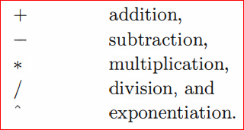
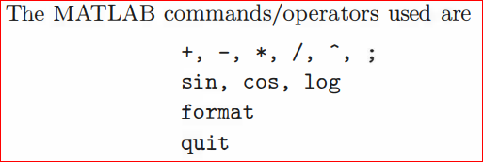
Arithmetic operations

Slide 3
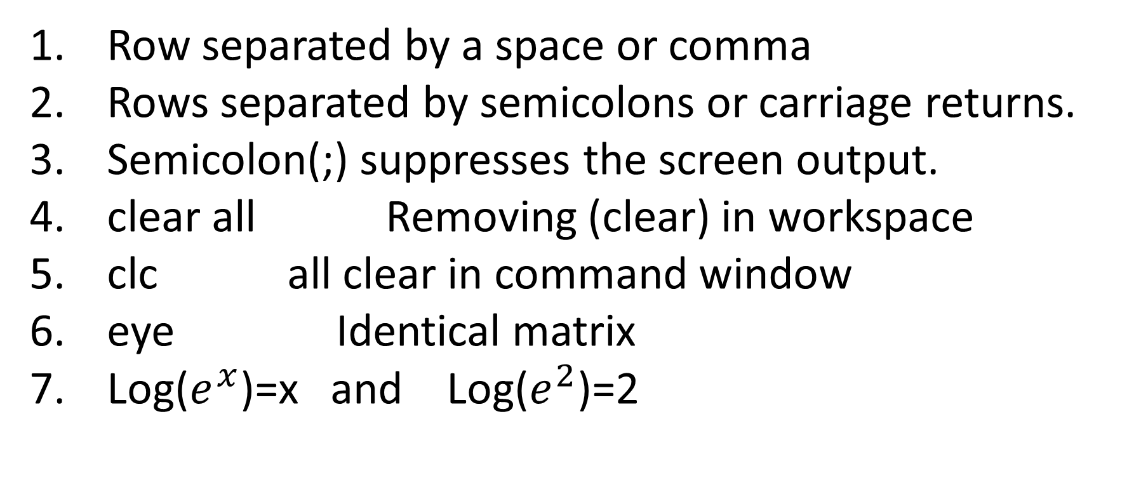
Row separated by a space or comma
Rows separated by semicolons or carriage returns.
Semicolon(;) suppresses the screen output.
clear all Removing (clear) in workspace
clc all clear in command window
eye Identical matrix
Log($e^{x}$)=x and Log($e^{2}$)=2

Slide 4
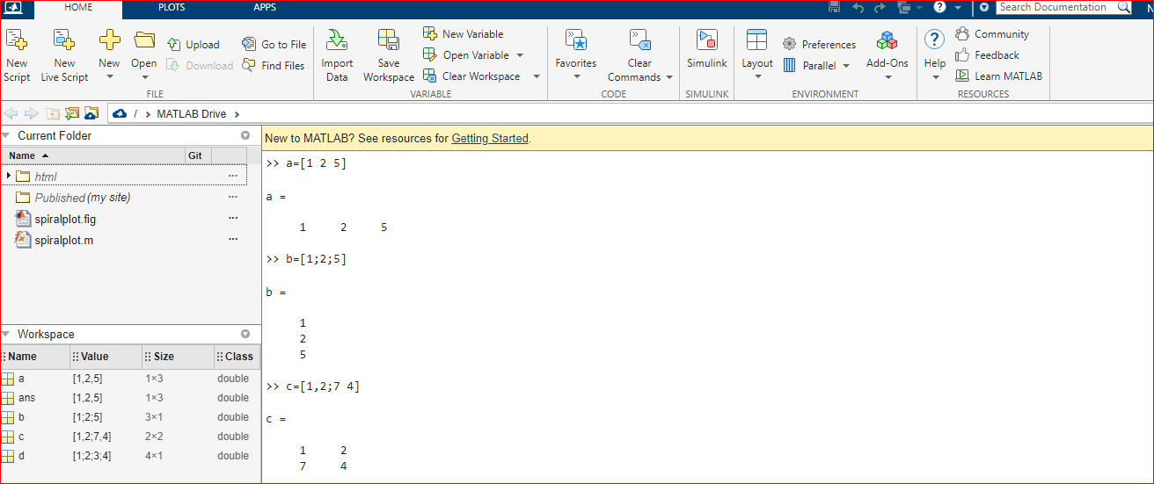

Slide 5
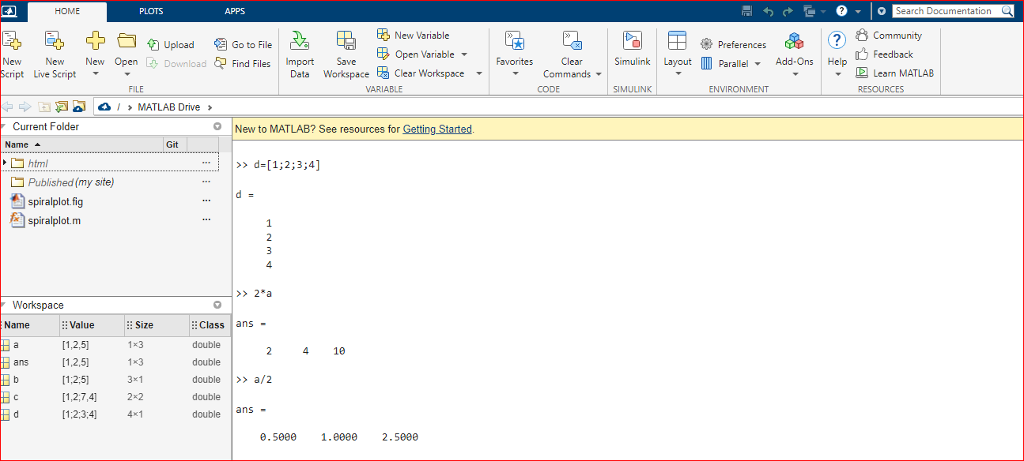

Slide 6
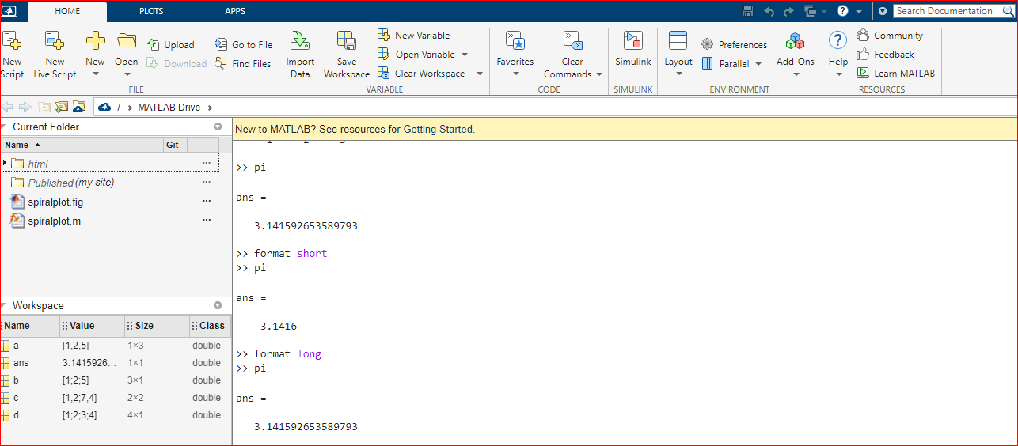

Slide 7
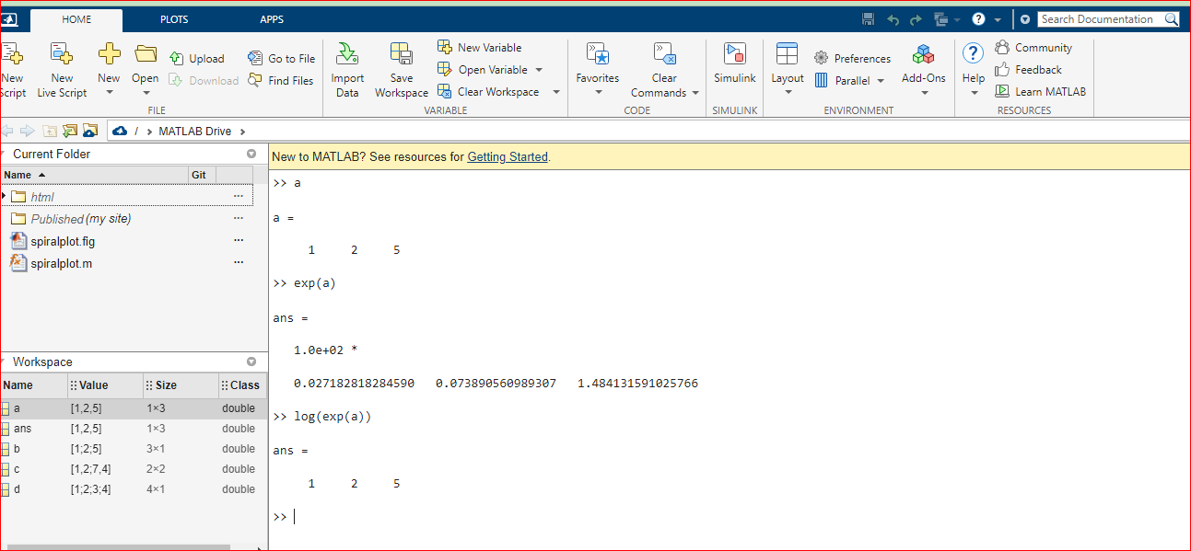

Slide 8
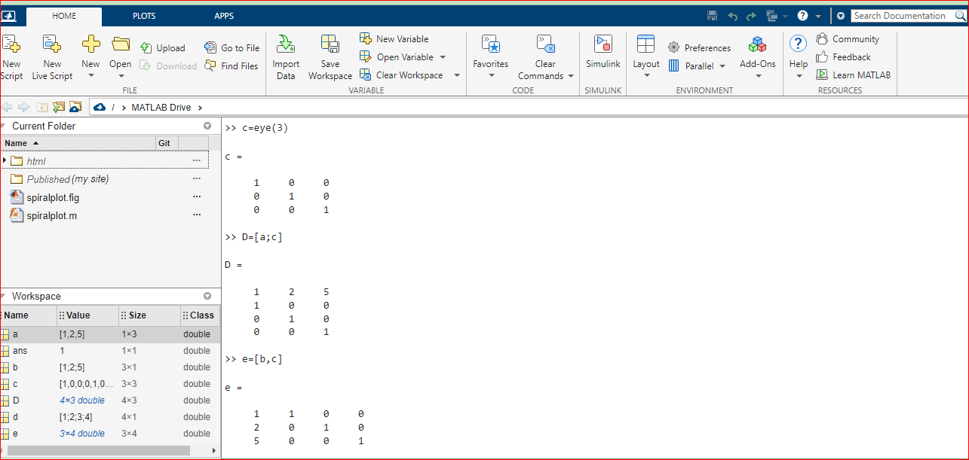

Slide 9
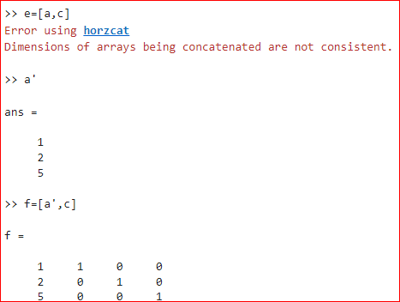

Slide 10
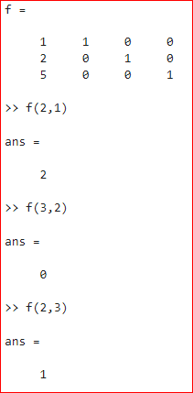

Slide 11
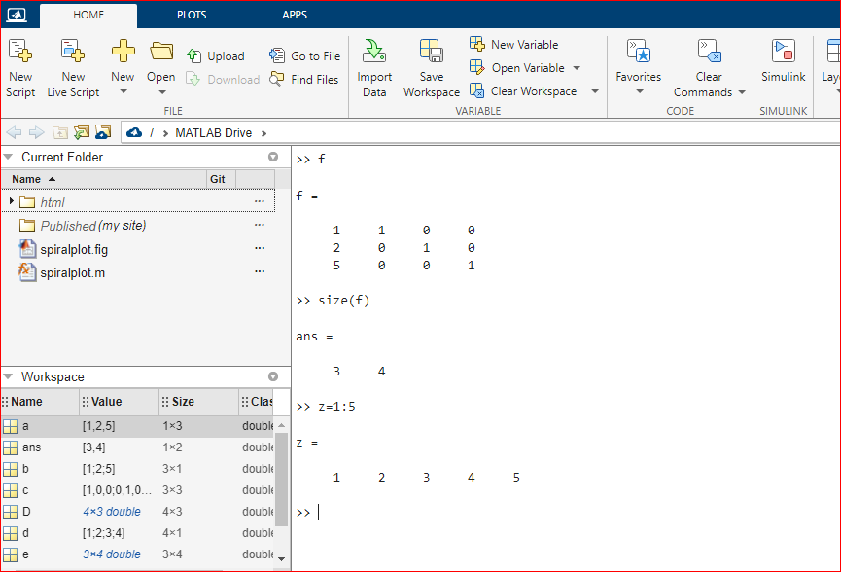

Slide 12
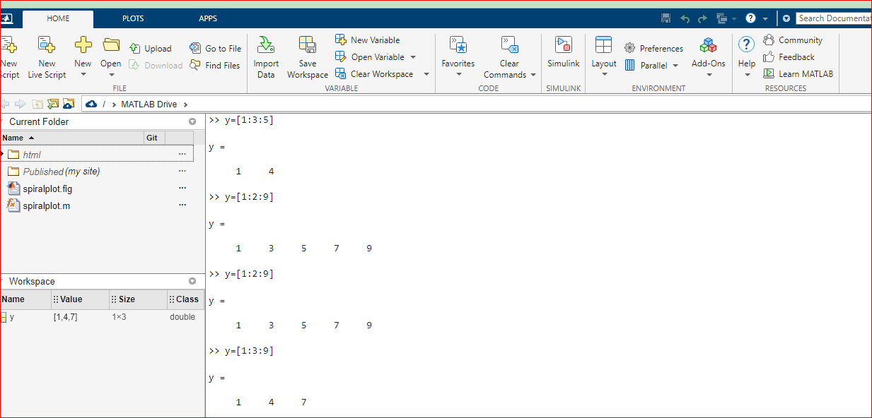

Slide 13
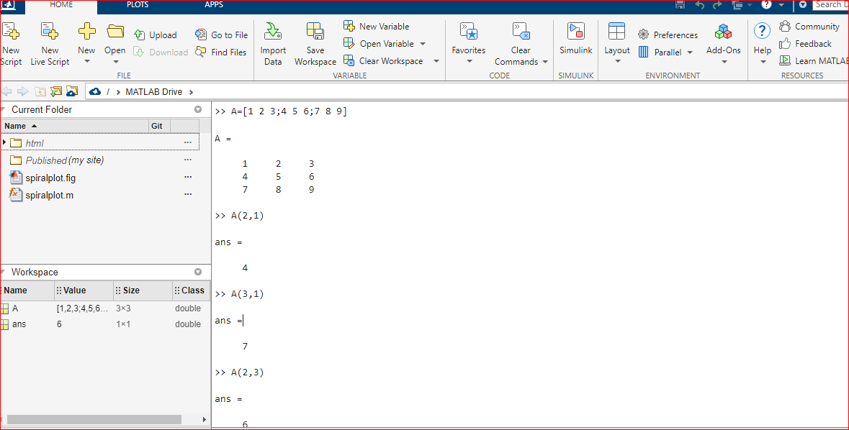

Slide 14
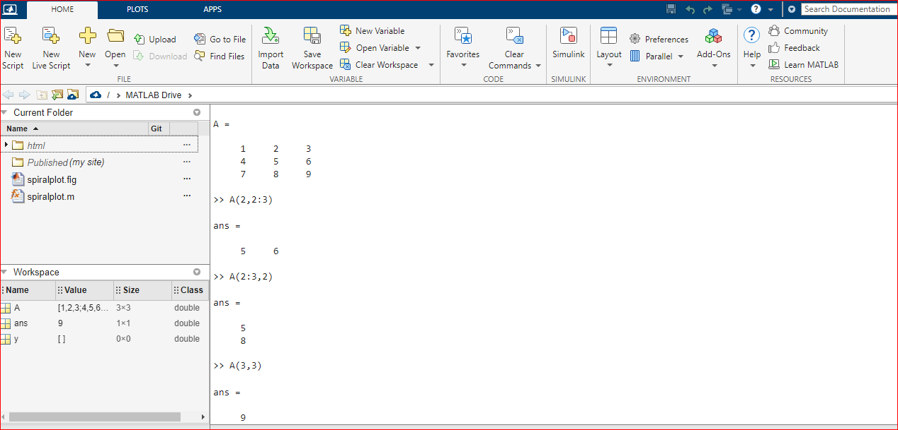

Slide 15
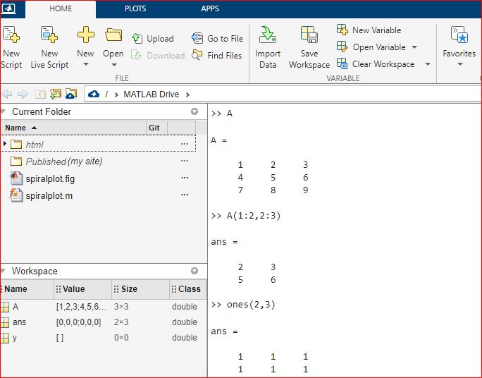

Slide 16
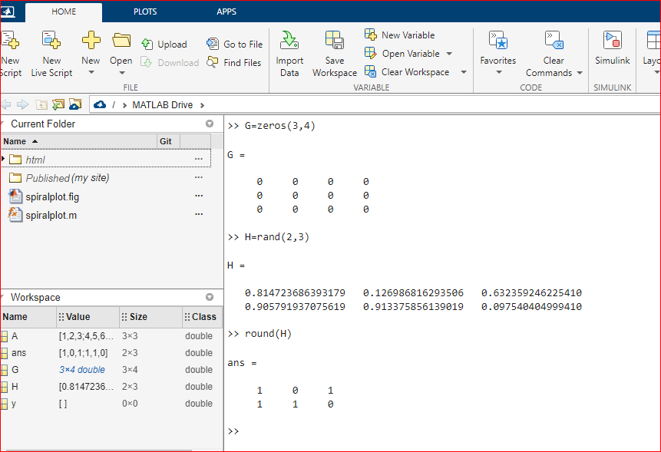

Slide 17

Thank you

